Slide 1
CROP PRODUCTION IN INDIA
DOMAIN: AGRICULTURE

Slide 2
STATEMENT
The Agriculture business domain, as a vital part of the overall supply chain, is expected to highly evolve in the upcoming years via the developments, which are taking place on the side of the Future Internet. This paper presents a novel Business-to-Business collaboration platform from the agri-food sector perspective, which aims to facilitate the collaboration of numerous stakeholders belonging to associated business domains, in an effective and flexible manner.
This dataset provides a huge amount of information on crop production in India ranging from several years. Based on the Information the ultimate goal would be to predict crop production and find important insights highlighting key indicators and metrics that influence crop production.
Make views and dashboards first and also make a story out of it.

Slide 3
DATASET DESCRIPTION
COLUMNS | DATATYPE | TOTAL VALUES
STATE_NAME | OBJECT | 33
CROP YEAR | INT64 | 19
CROP | OBJECT | 124
DISTRICT_NAME | OBJECT | 646
SEASON | OBJECT | 6
AREA | FLOAT64 | 38442
PRODUCTION | FLOAT64 | 51628

Slide 4
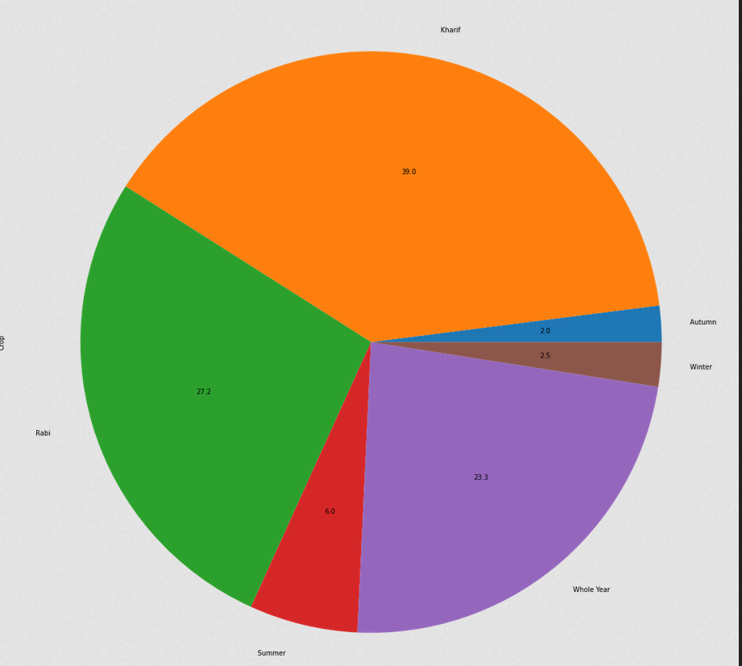
SEASONWISE CROP PRODUCTION.

Slide 5
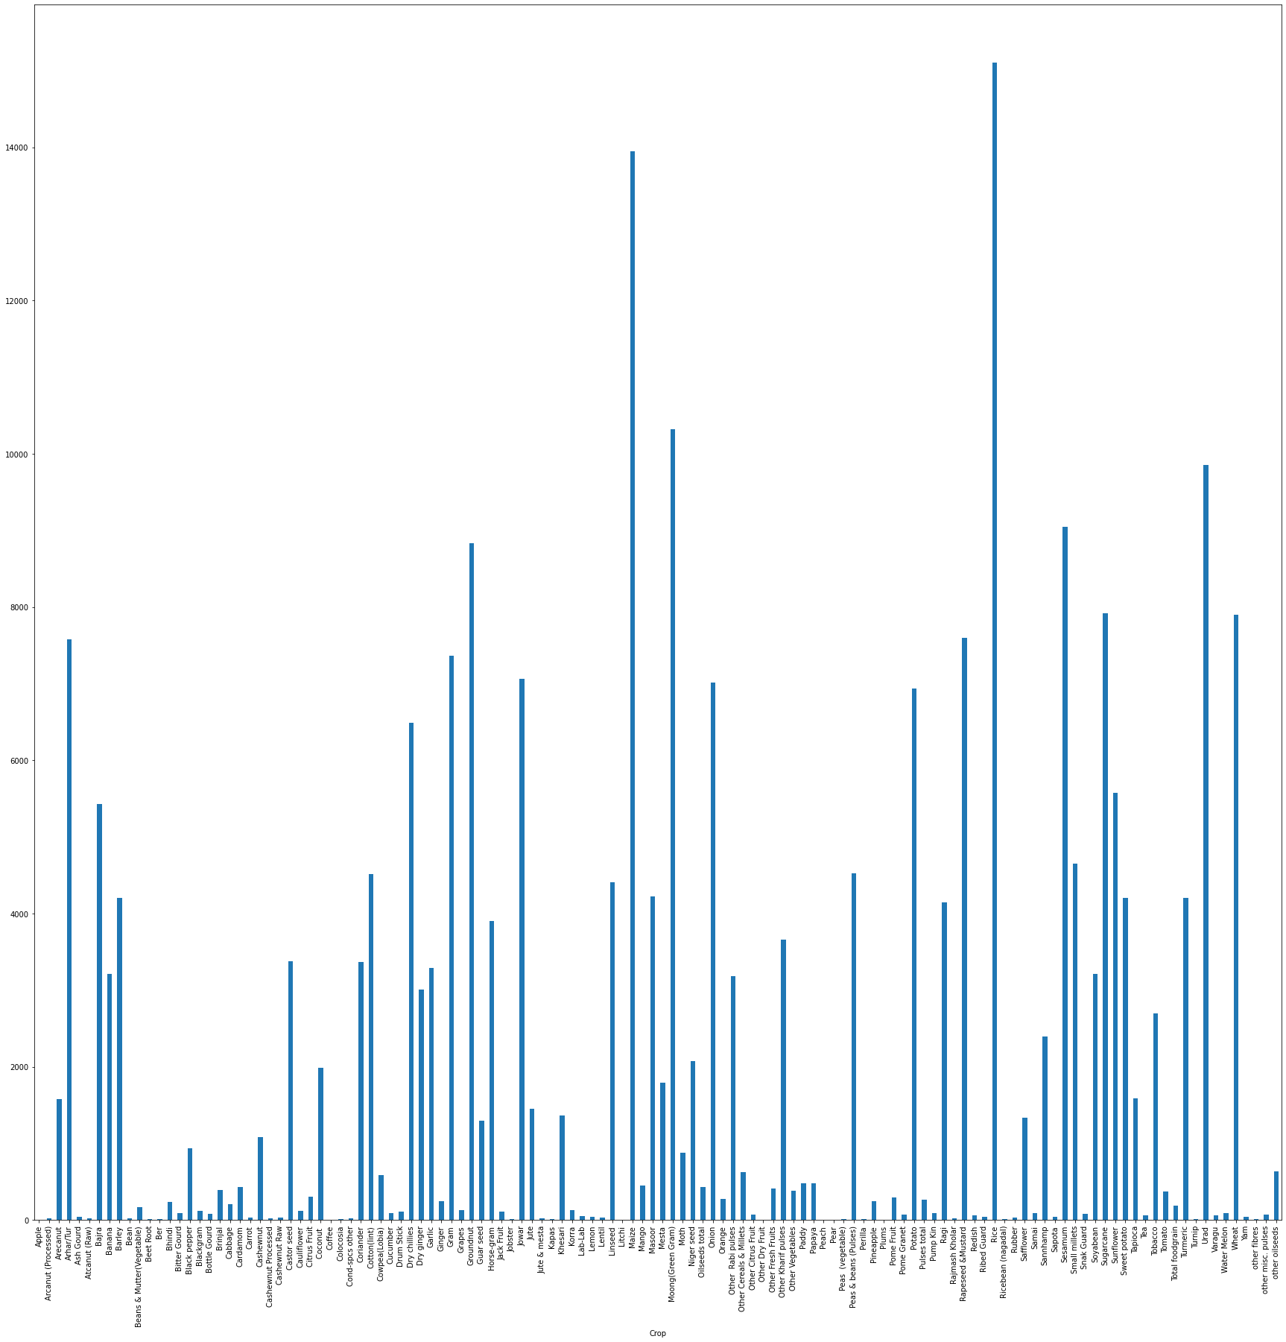
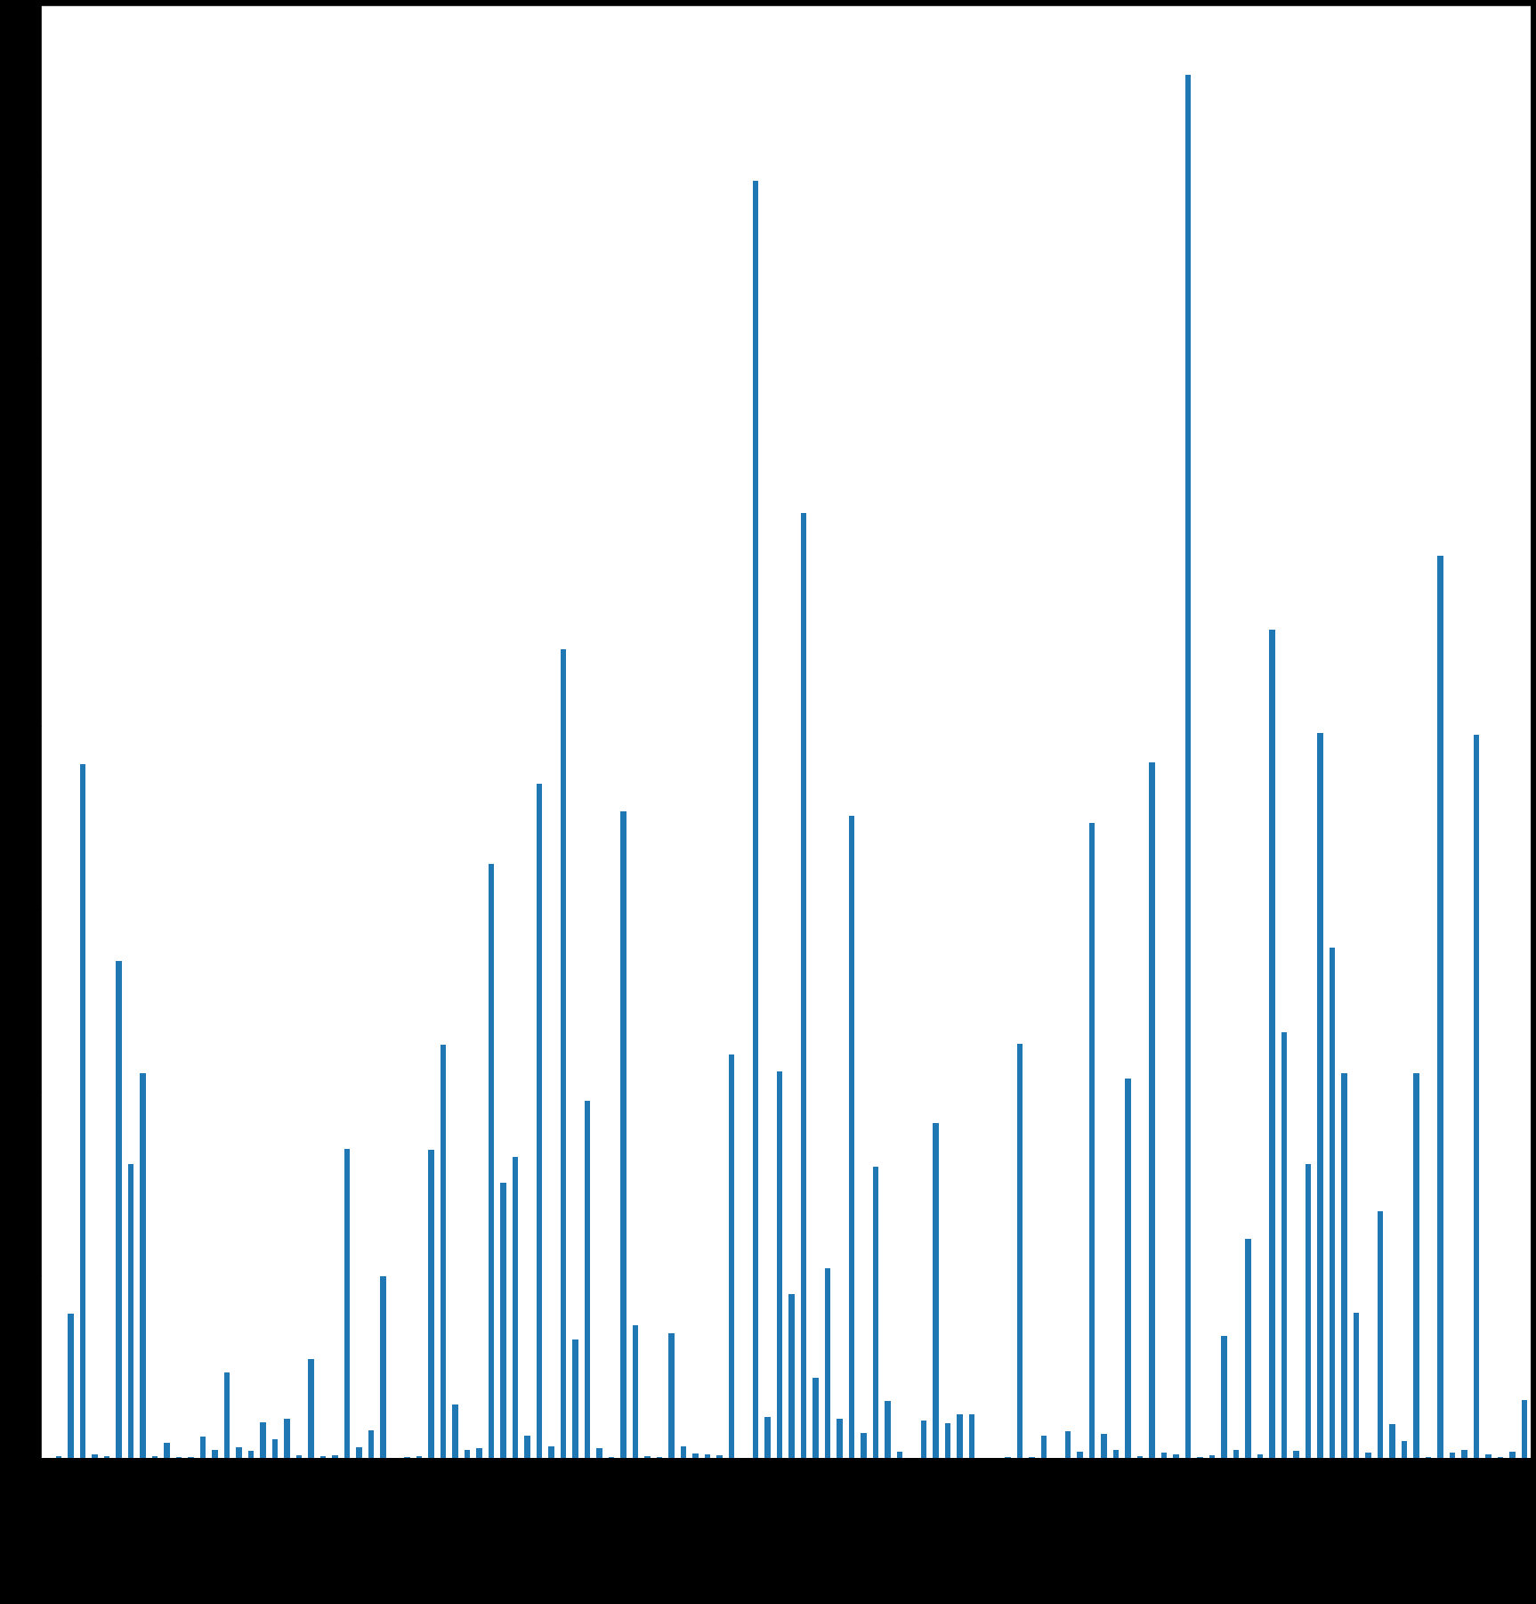
Production vs Crop.

Slide 6
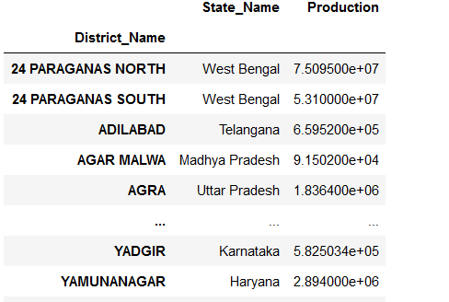
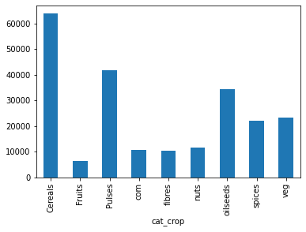
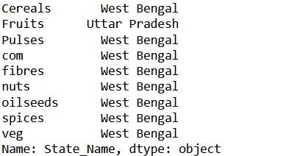
Production vs Crops-State Wise and District Wise.

Slide 7
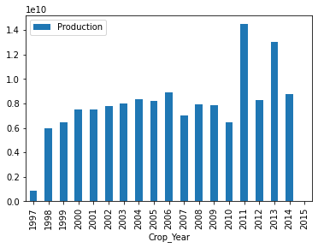
Yearwise Production

Slide 8
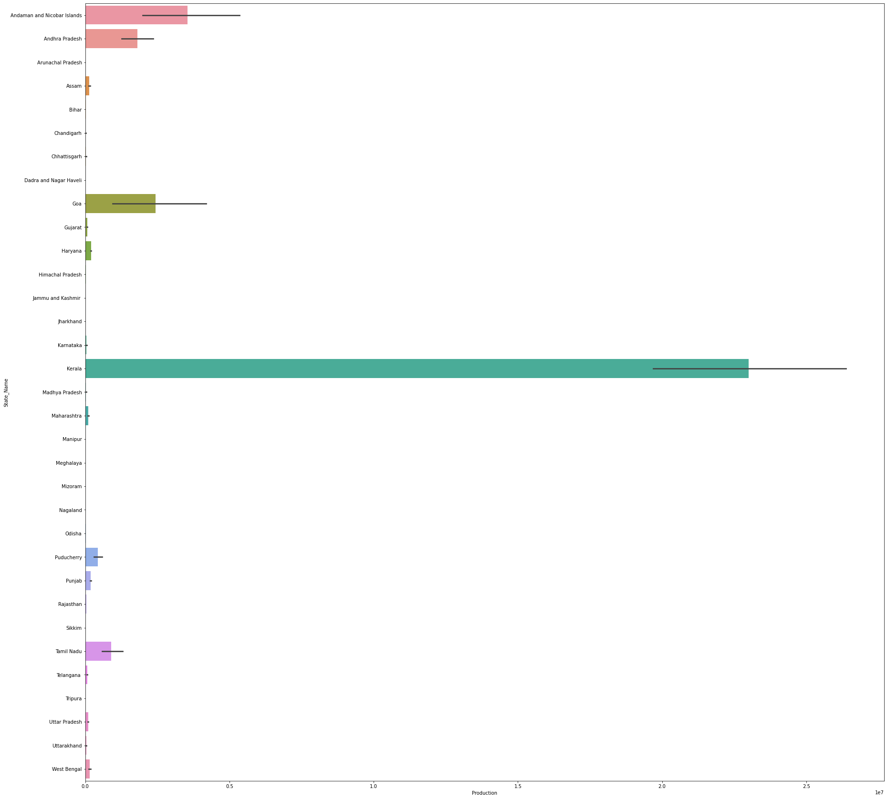
Statewise production

Slide 9
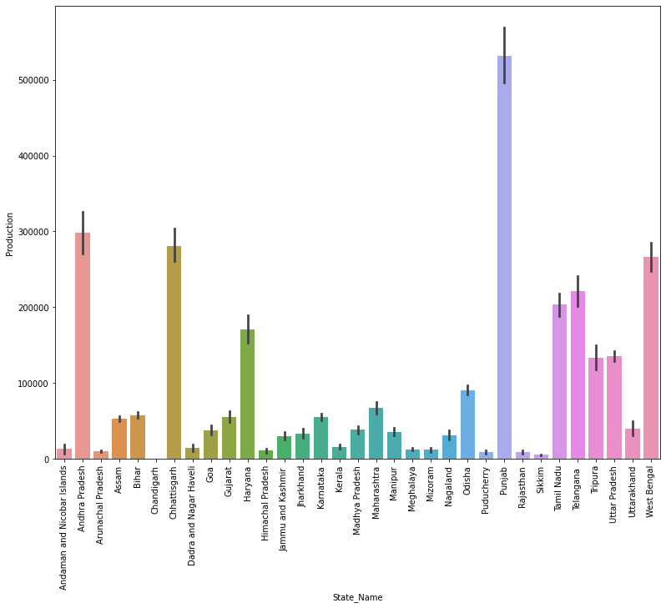
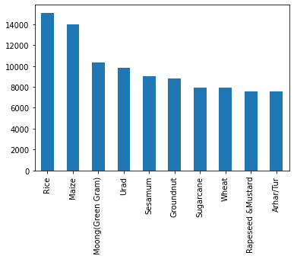
Topmost crop production

Slide 10
Least Crop Production

Slide 11
Conclusion
Although in our country different state and district do produce various kinds of crops but cereals is the topmost crop produced amongst which Uttar Pradesh, Punjab and some parts of south are the topmost producers of rice.
Least produced crop is dry fruit only one district i.e RangaReddy and oilseeds are the crops produced less and highly produced in rajasthan.
Fruits are highly produced in Uttar Pradesh.
Crops are maximum sown in the beginning of monsoon season and cultivated in end of monsoon season(Kharif Season).
Highest cultivation or production is done in the year 2012 and less in 2015.

